Slide 1
Mobile Automation Testing With
Appium
測試規劃科(Quality Assurance)

Slide 2
Agenda
What is Appium.
Appium Architecture?
Advantages in Adopting Appium ?
Challenges in Appium ?
Demo

Slide 3
Appium
Appium is an open-source test automation tool
Allows testing for all types of Mobile Applications
Native Apps, Hybrid Apps and Mobile Web Apps
It is Cross-Platform

Slide 4
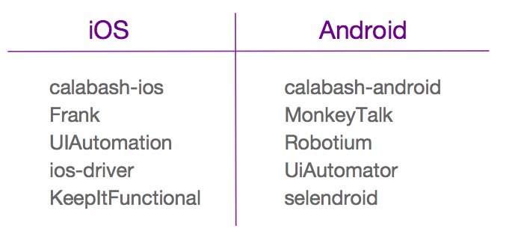

Appium ..Contd

Slide 5
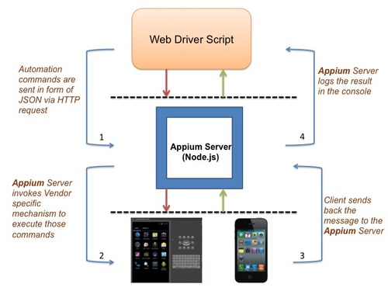
Appium Architecture

Slide 6
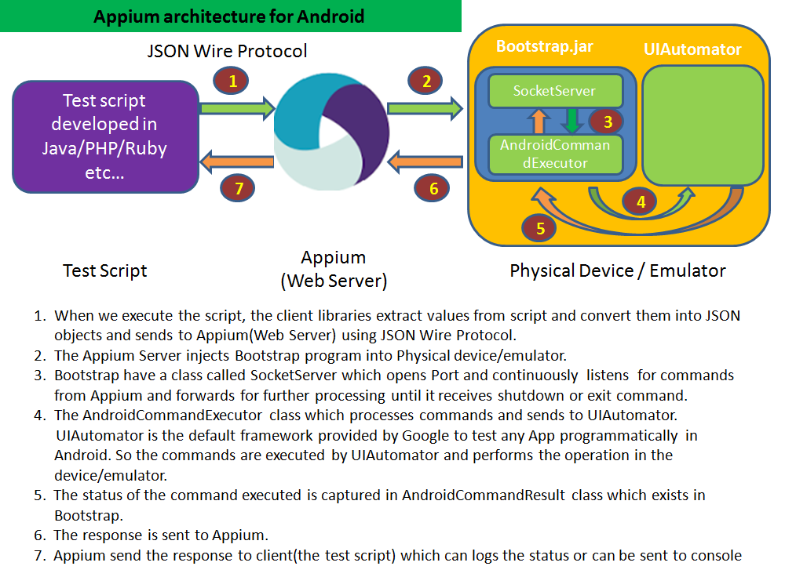
Appium Architecture

Slide 7
Advantages Of Appium
Appium supports most of the Programming languages like java,ruby,php,C#, ..etc.
Supports automation of All types of Apps(Native, Web & Hybrid).
Compatible with Selenium Web Driver
Truly Cross-Platform
Can run both Android & Appium test cases in same machine(Mac OS)

Slide 8
Challenges in Appium
No image comparison.
Doesn't support testing of Android Version lower than 4.2(Selendroid/Robotium )
Limited support for testing Hybrid App
Long time to configure Appium for both android and iOS
Cannot support parallel execution in Mac OS

Slide 9

Q & A

